Slide 1
T21 - Groove Galaxy
Safe Sound Cryptography library, infrastructure and functionality
99078: Guilherme Carabalone
99095: João Furtado
93634: Diogo Gonçalves

Slide 2
Secure Documents
Protect: Encrypts the audio content of a JSON file with a symmetric disposable key and a mix of timestamp and a random number to guarantee freshness.
Unprotect: Decrypts the audio content with the disposable key.
Check: Verifies the authenticity of a media document by checking the timestamp, random number, and hash.

Slide 3
Secure Documents: Design
Our library guarantees confidentiality, authenticity and integrity of the media:
Confidentiality: Disposable key is encrypted by a symmetric key which is only shared by the client and server.
Integrity: A HMAC is used.
Freshness: Timestamp and random number are used.
Authenticity: Freshness + Integrity guarantees authenticity.

Slide 4
Critical information
The document's crucial information was identified as solely the audio data.
We encrypt the audio with a disposable key, and this disposable key is encrypted with the long term key (FK). This ensures confidentiality and that we don't overuse the long term key.

Slide 5
Freshness
We use a combination of a random number and timestamp to guarantee freshness for:
Unpredictability: Random numbers can prevent an attacker manipulating the system by predicting the nonce with a counter for example.
Only one server: We don't need to worry about clock synchronization between multiple servers.

Slide 6
Integrity
We used a HMAC over DS to ensure integrity:
Non-Repudiation: We didn't need to guarantee non-repudiation.
Key Management: In the beginning we assumed that the user and server already shared a secret key, avoiding key distribution.

Slide 7
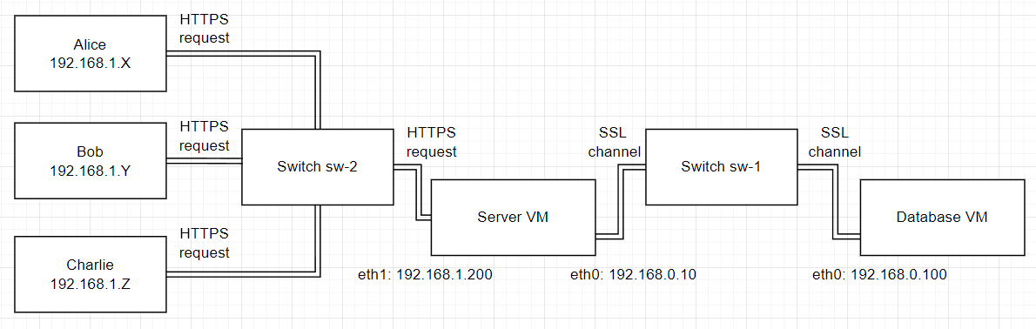
Infrastructure (General)
3+ VMs running Kali Linux.
Server VM: runs a Flask server accepting HTTPS requests.
Database VM: runs PostgreSQL database.
Client VM: one or more VMs running our client application.

Slide 8
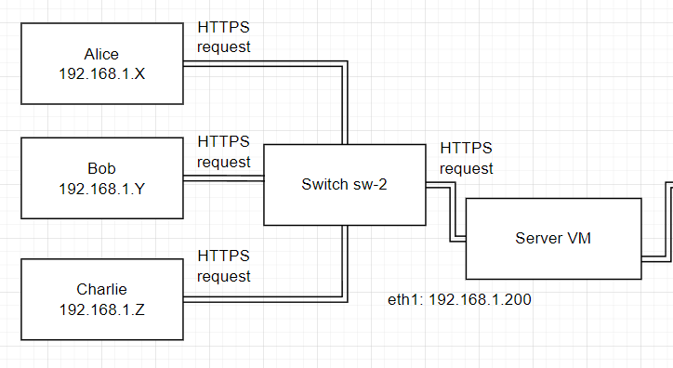
Client
This VM is mostly left at the default stage, to run a client we only need:
A copy of server certificate.
The client script.
The installed dependencies
Exposure to the sw-2 switch that handles communication with the server.
The client can only communicate with the server via TLS/SSL using its copy of the certificate signed by the server, since the firewall blocks any packets that do not come from port 443

Slide 9
Server
The server:
Is exposed to two switches, one for server-client communication (sw-2) and one for server-database communication (sw-1)
The server only listen for requests coming from port 443
Denies telnet connections
Denies ICMP echo requests
To handle secure communication with its clients, the server emits a self signed certificate that:
Is generated with a 4096 RSA key
Is valid for 365 days
Is explicitly intended for communication to 192.168.1.200 (server IP exposed to sw-2)
Is pre-distributed to every client.
The client uses this certificate to make HTTPS requests to the server

Slide 10
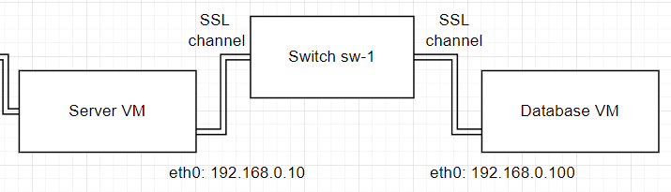
Database
The database:
Is exposed to sw-1, to communicate with the server
Only listen for requests coming from port 443
Only allows connections to the database server coming from the server IP, database IP, or localhost.
Denies telnet connections
Denies ICMP echo requests
Database secure channel:
The database server uses SSL/TLS to communicate.
The database VM generates a self-signed certificate that is used by the postgres server to secure communication.

Slide 11
Security Challenge
Use cryptography options that allow playback to quickly start in the middle of an audio stream, optimizing user experience without compromising security.
Add the concept of family sharing, where individual users can be members of the same family, and a protected song should be accessible to all family members without modification.
Each user still only has its own key, so, some dynamic key distribution will have to be devised.

Slide 12
Security Challenge
Streaming: despite our efforts to make streaming work, we ended up not accomplishing this one goal as intended.
The idea we tried to implement was changing the cipher mode from CFB to CTR and streaming the song data in 1024 byte chunks. The JSON with the metadata would be sent in one chunk and then the encrypted audio content would be streamed, with each chunk being decrypted by the client on arrival. After the audio content was fully received and decrypted, it would be added to the JSON and we would use our library to check its integrity.

Slide 13
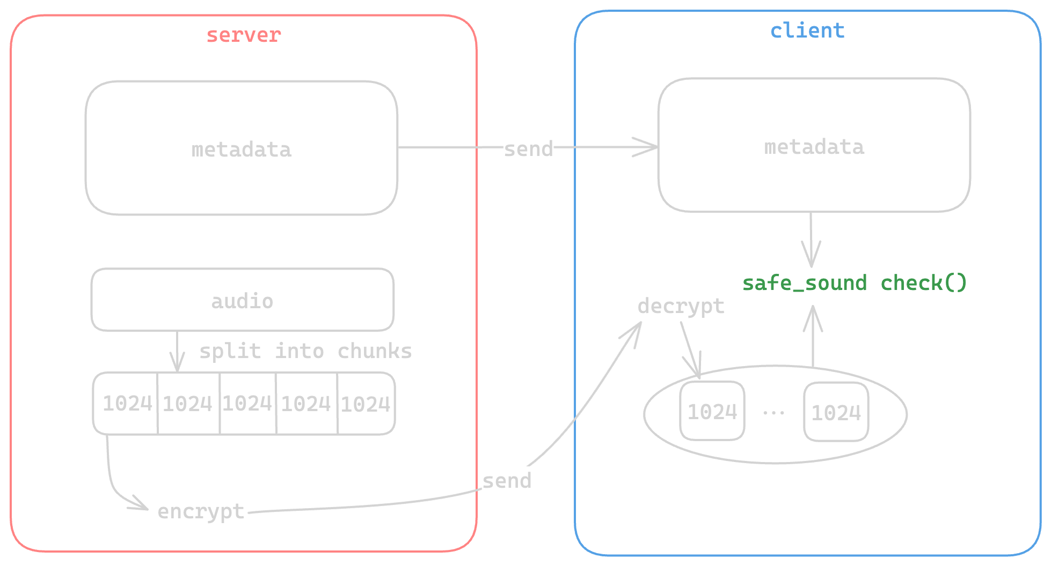
Streaming

Slide 14
Security Challenge
Family Sharing: with the requirement to add family sharing to our application, some things had to change. Firstly, we introduced a new table to the database, representing a Family.
At first, we had a single key which the system’s intervenients already knew beforehand. With the introduction of families, there was the need for users belonging to the same family to be able to decrypt the audio content of a song which was bought by a family member, so we needed to design a new key system.

Slide 15
Family Sharing
We added the concept of Family Key(FK): a key unique to each family used to secure media a family can access.
Assume the previously known keys are FKs (at the beginning, each family is comprised of a single user).
On register, a client generate a RSA public-private key pair, and sends its Public Key (PuK) to the server, encrypted with its FK. The server decrypts with the FK and stores the user’s PuK.

Slide 16
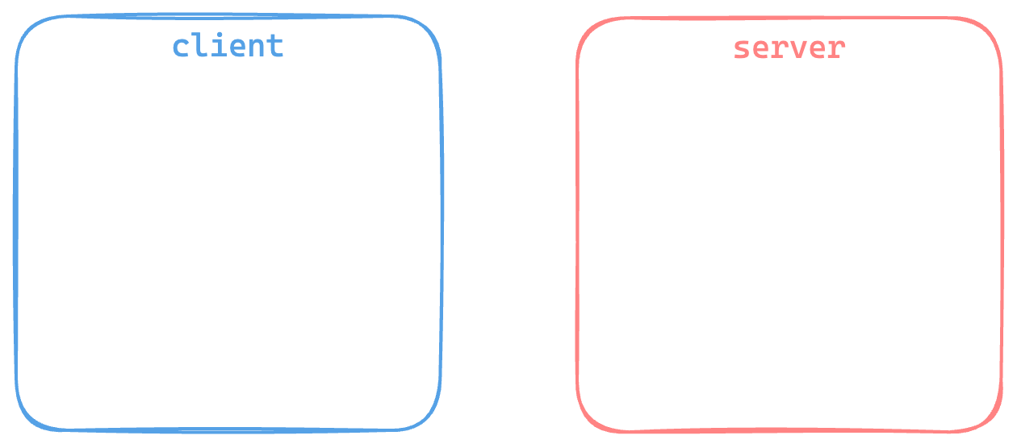
Key Distribution
register

Slide 17
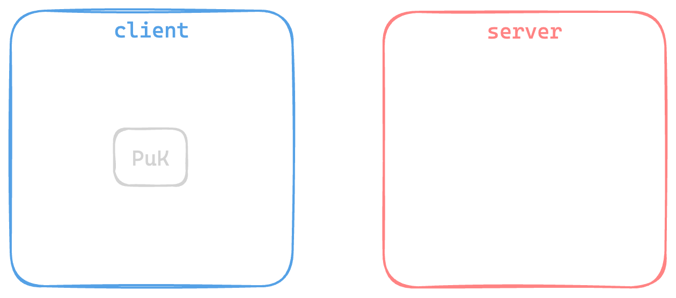
Key Distribution
register

Slide 18
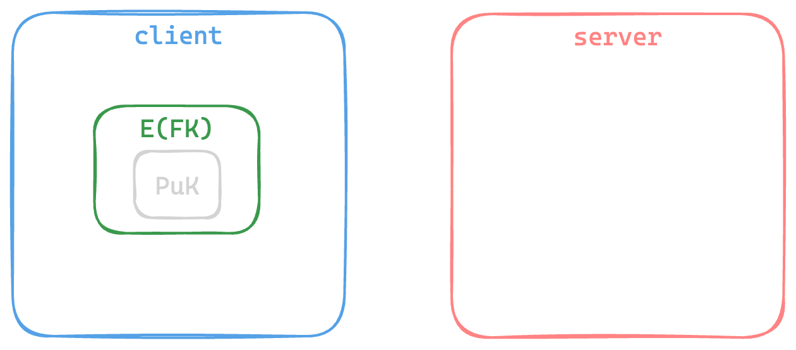
Key Distribution
register

Slide 19
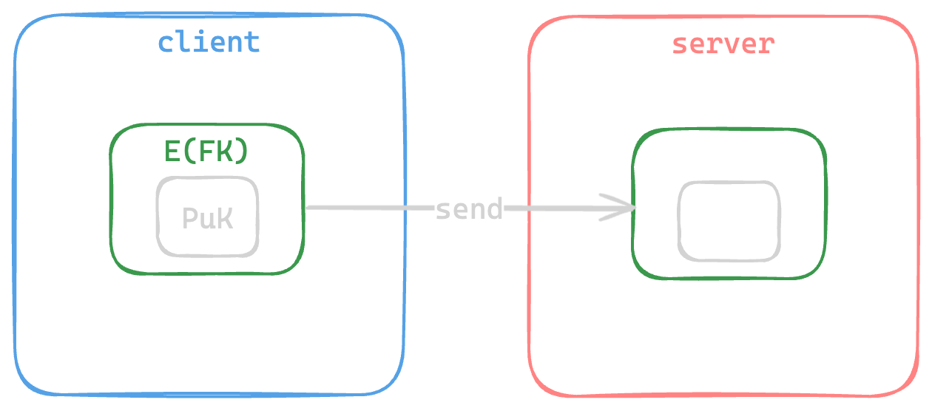
Key Distribution
register

Slide 20
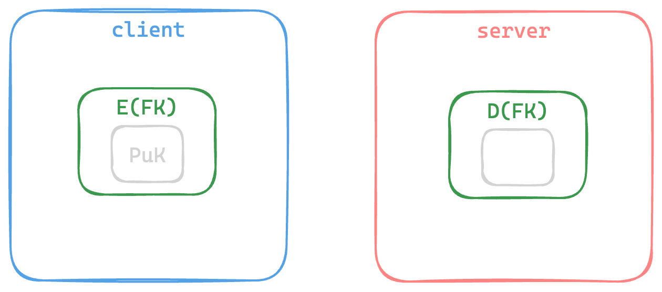
Key Distribution
register

Slide 21
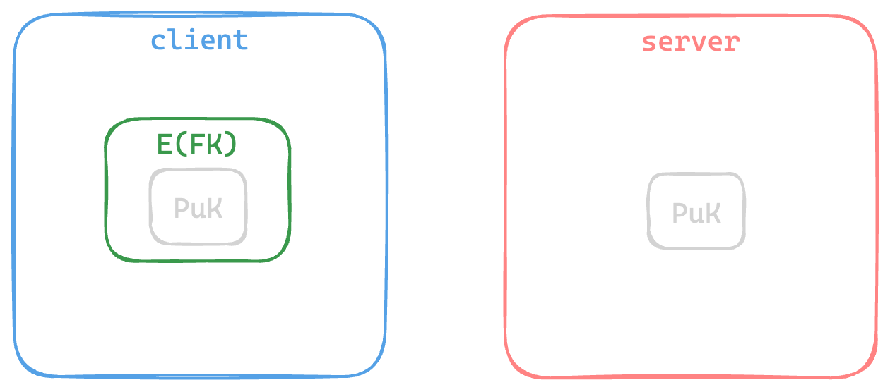
Key Distribution
register

Slide 22
Key Distribution
When a user joins a family, the server sends that family’s FK encrypted with the user’s PuK. In the client side, the message is decrypted with the user’s Private Key (PvK) and the new FK is stored.

Slide 23
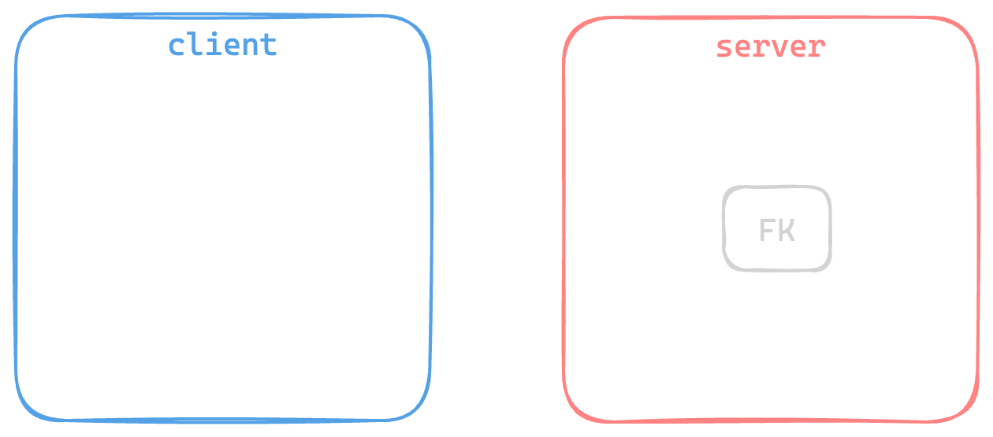
Key Distribution
join family

Slide 24
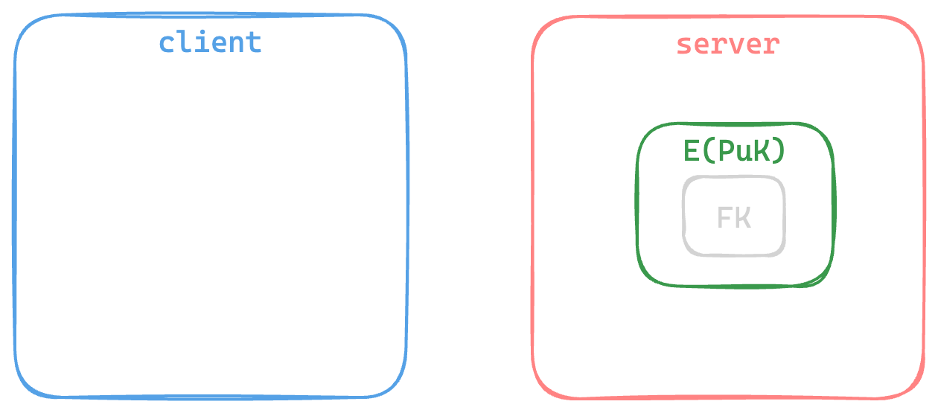
Key Distribution
join family

Slide 25
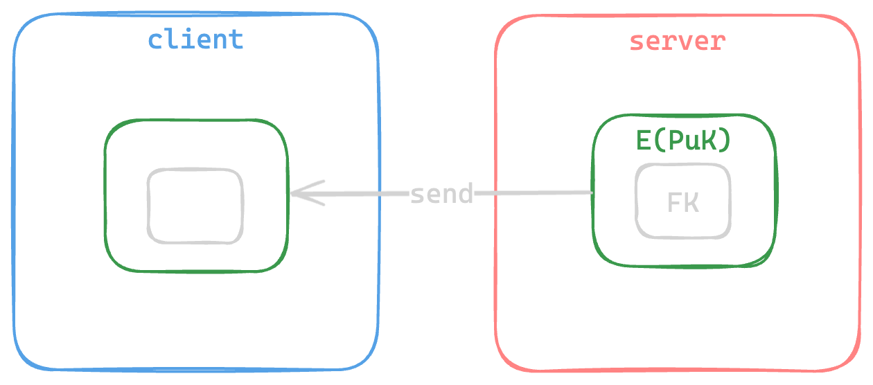
Key Distribution
join family

Slide 26
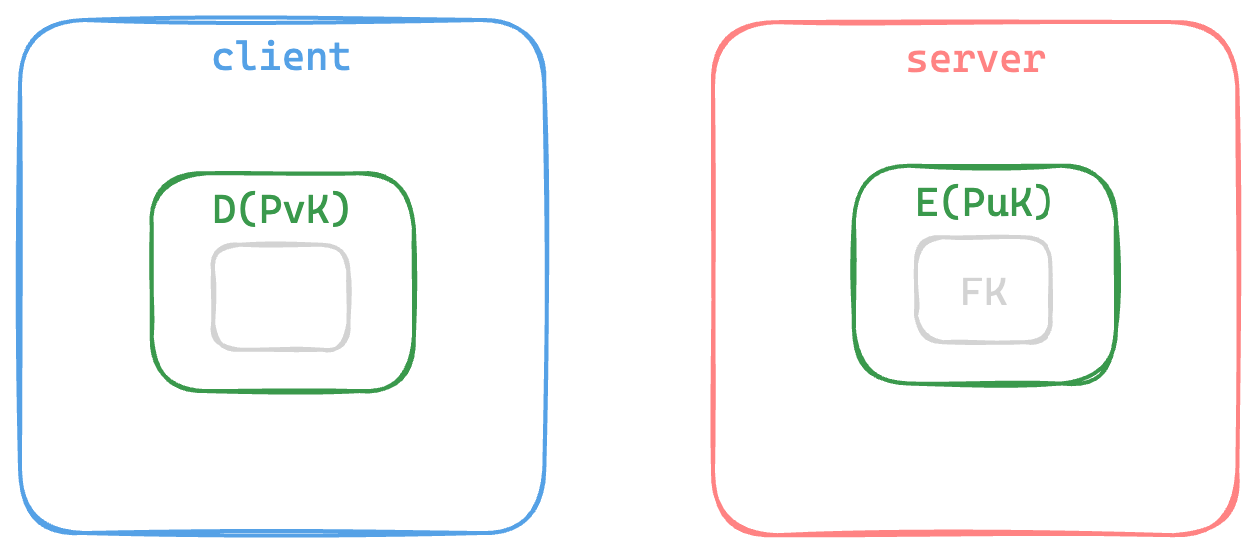
Key Distribution
join family

Slide 27
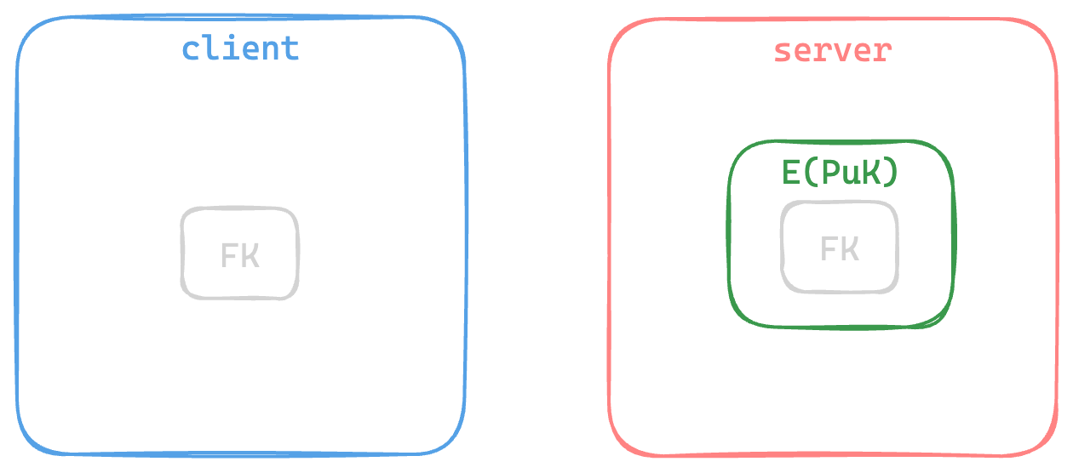
Key Distribution
join family

Slide 28
Family Sharing
When sending audio content, the server generates a Throwaway Key (TK) and encrypts the song data with it. Then the server bundles the encrypted audio content together with the TK itself and encrypts this bundle with FK. By encrypting with a single-use key, we make the system more resilient to cryptanalysis when compared with encrypting with the FK alone.
In the client side, the received message is decrypted with the FK, obtaining the TK. Then the encrypted audio is decrypted with the TK, obtaining the desired data.

Slide 29
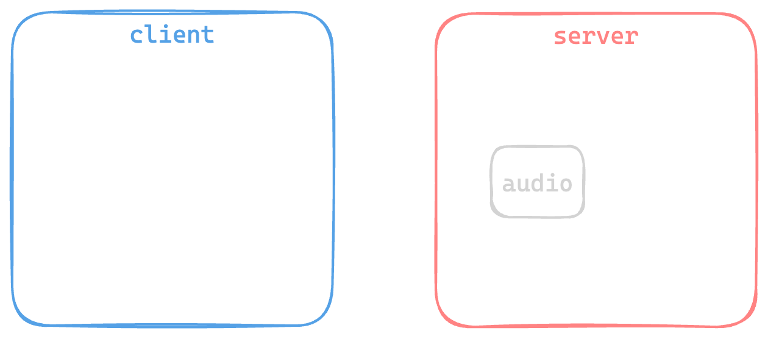
Family Sharing
access media

Slide 30
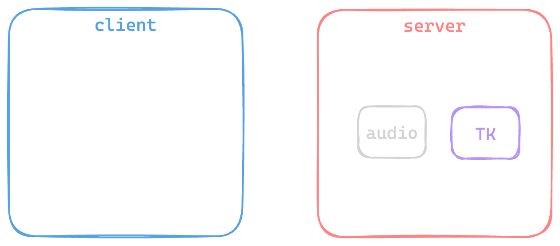
Family Sharing
access media

Slide 31
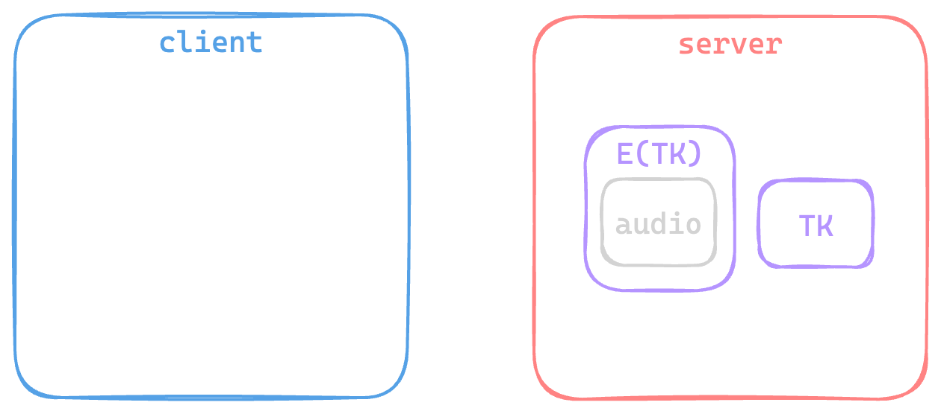
Family Sharing
access media

Slide 32
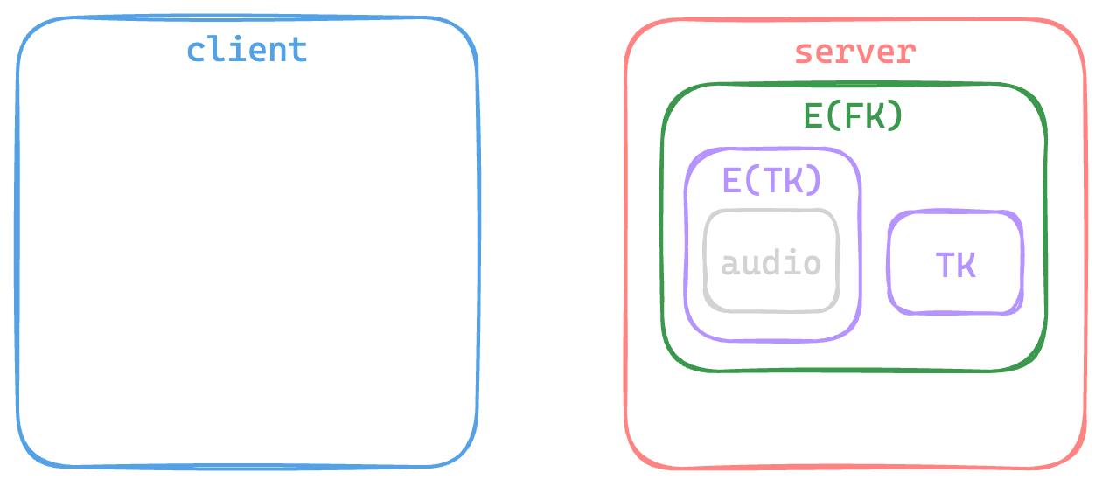
Family Sharing
access media

Slide 33
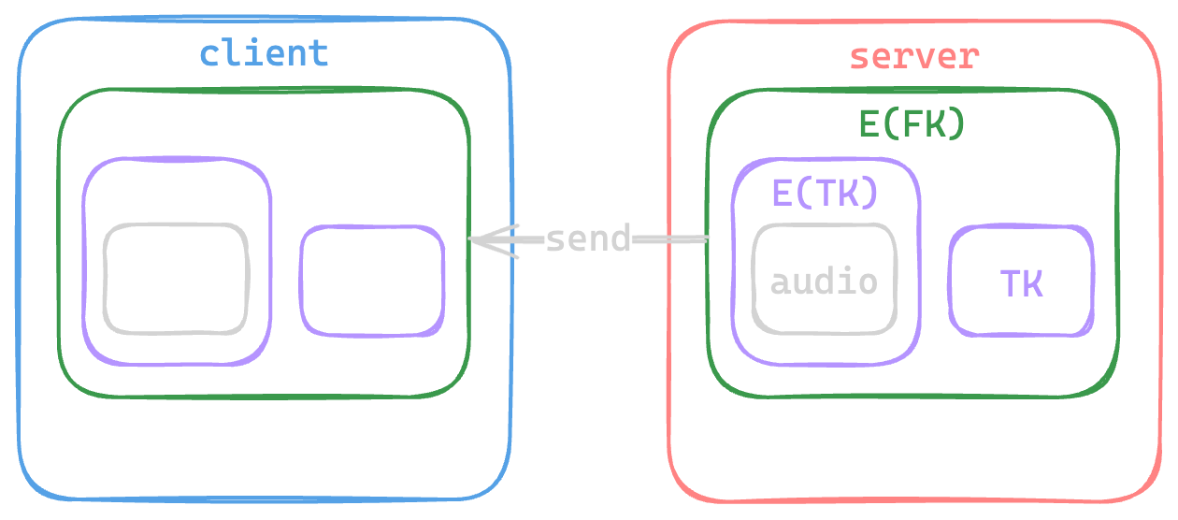
Family Sharing
access media

Slide 34
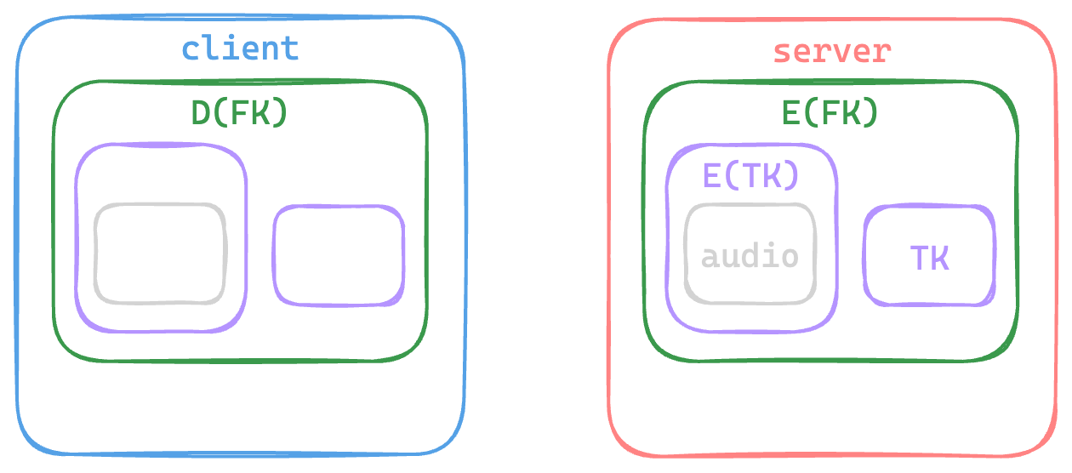
Family Sharing
access media

Slide 35
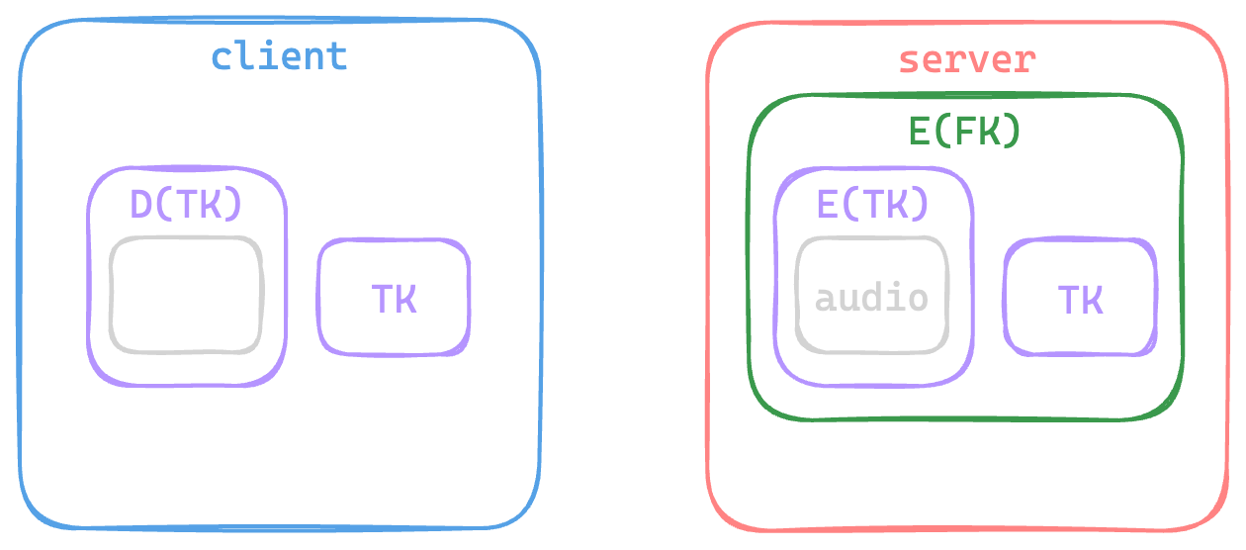
Family Sharing
access media

Slide 36
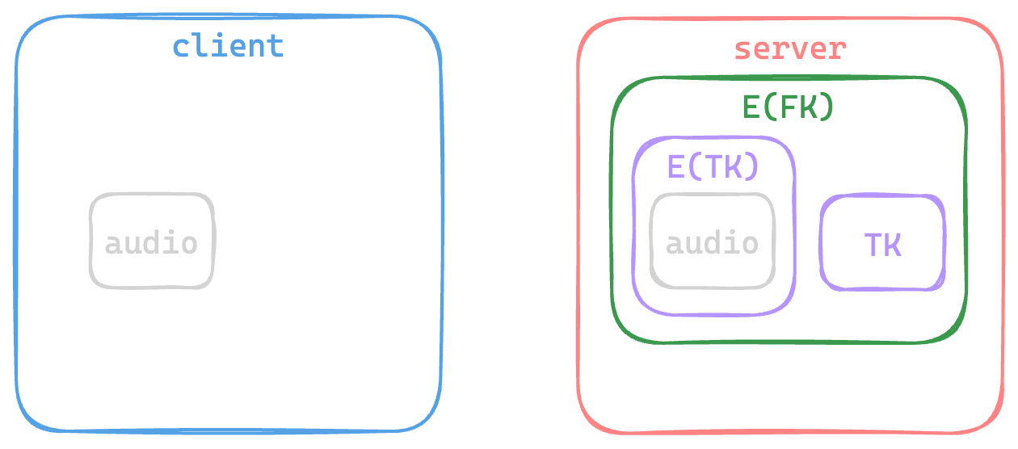
Family Sharing
access media

Slide 37
Results and Conclusion
Successfully developed a robust security application by employing safe key distribution and developing a secure documents library while using a safe infrastructure.
Simulated man-in-the-middle attacks, ICMP floods, and port scans. The application demonstrated resilience against these simulated attacks.
Future Improvements: audio streaming

Slide 38
Questions and Answers

